Slide 1

Commissioned by
Words and Music by Tim Gilvin and Louise Jordan
Inclusive Unit Designed by Emma Hughes
Words and Music by Tim Gilvin and Louise Jordan
Inclusive Unit Designed by Emma Hughes

Slide 2
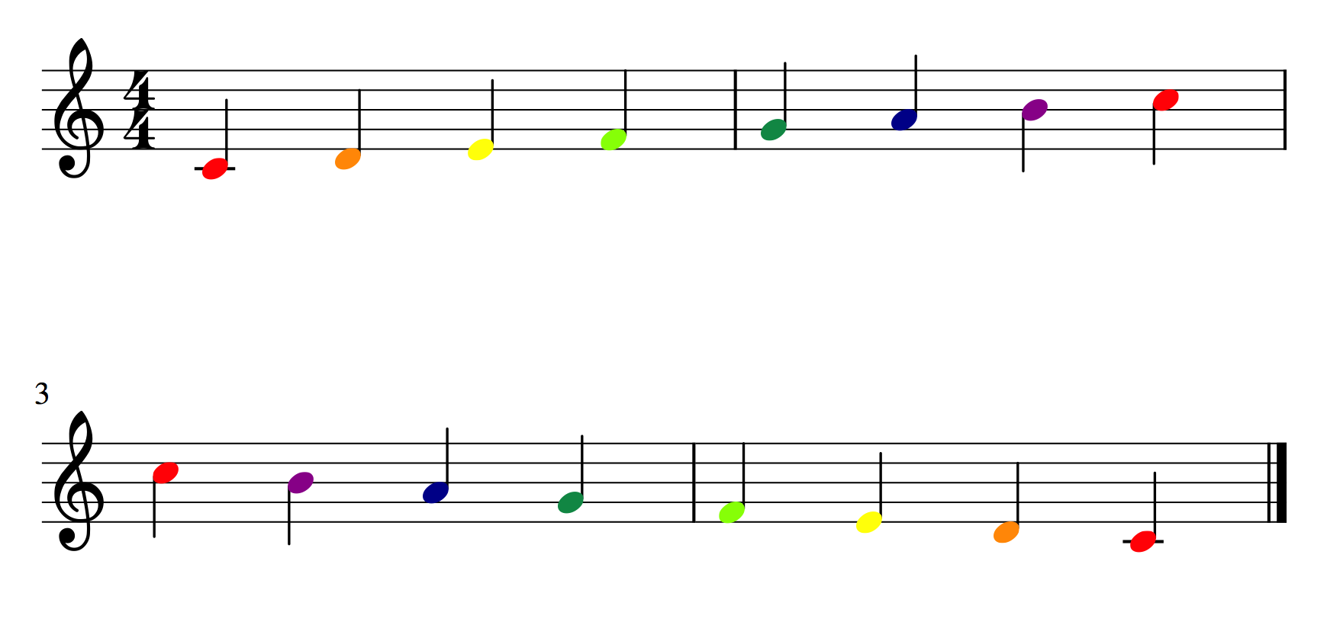

Slide 4
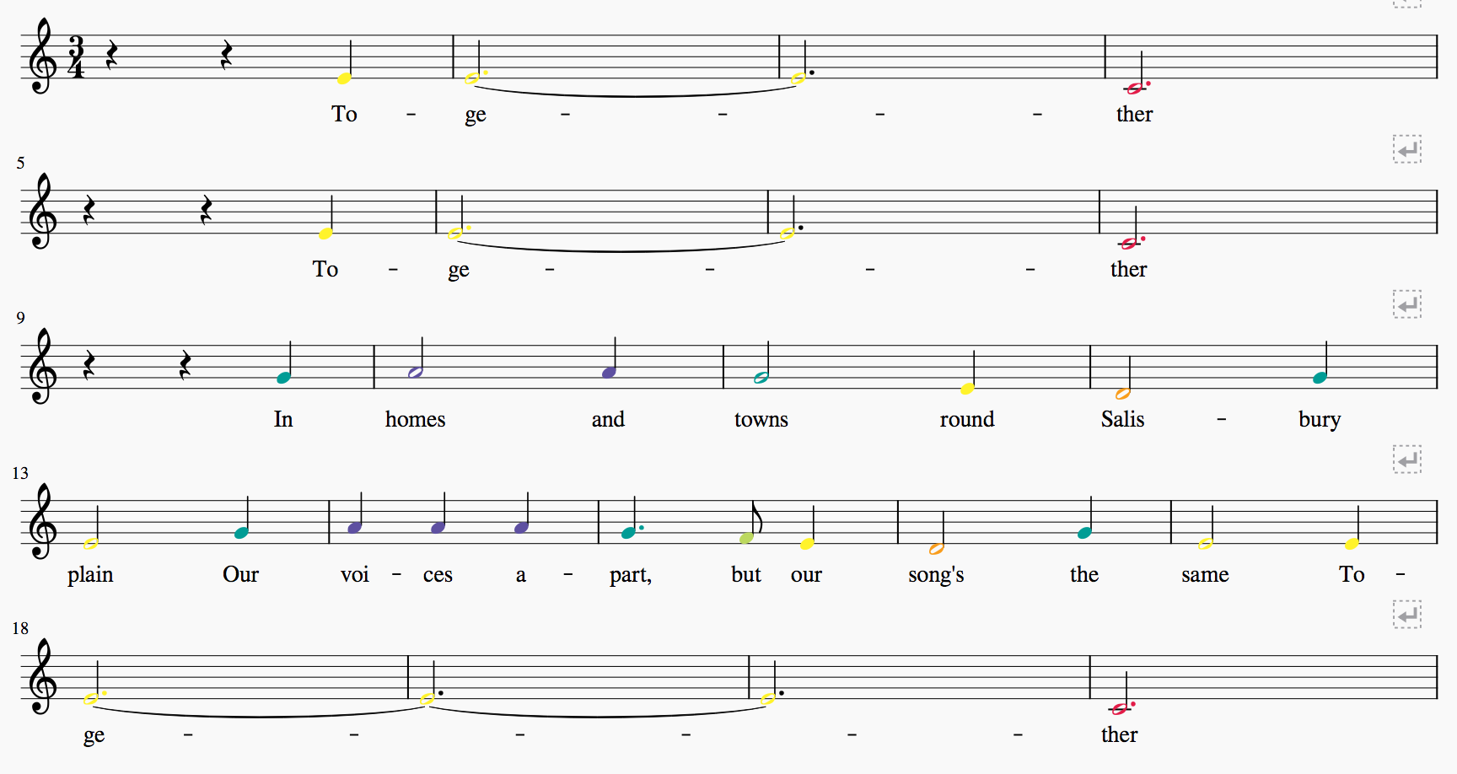

Slide 5
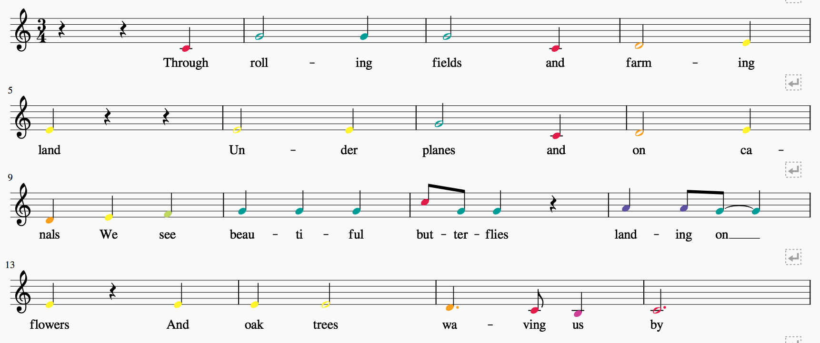

Slide 7
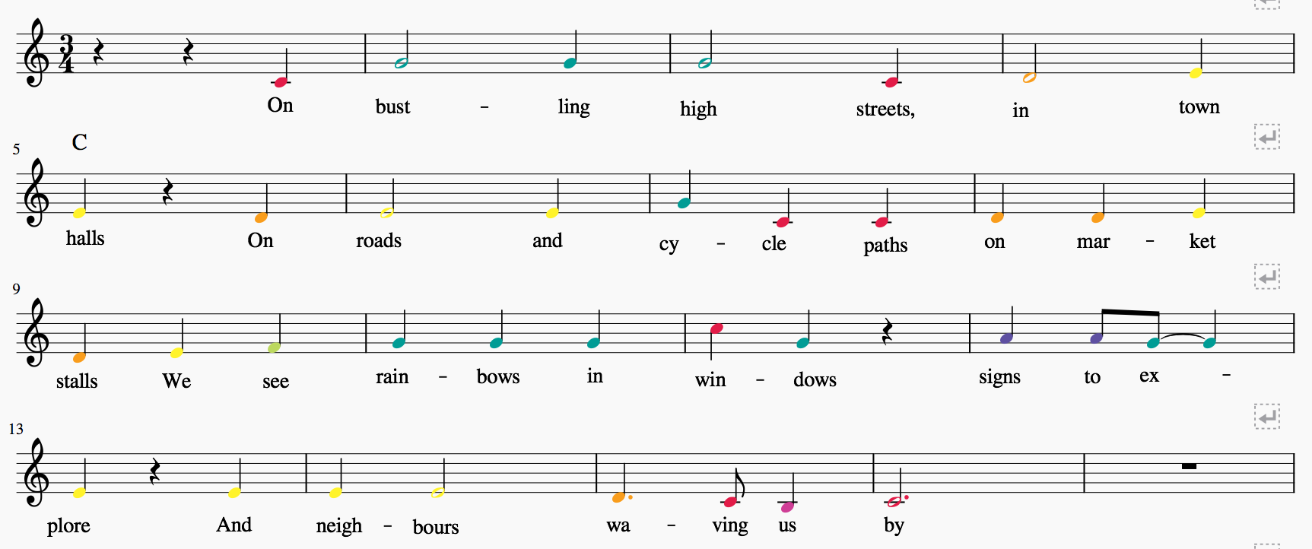

Slide 9
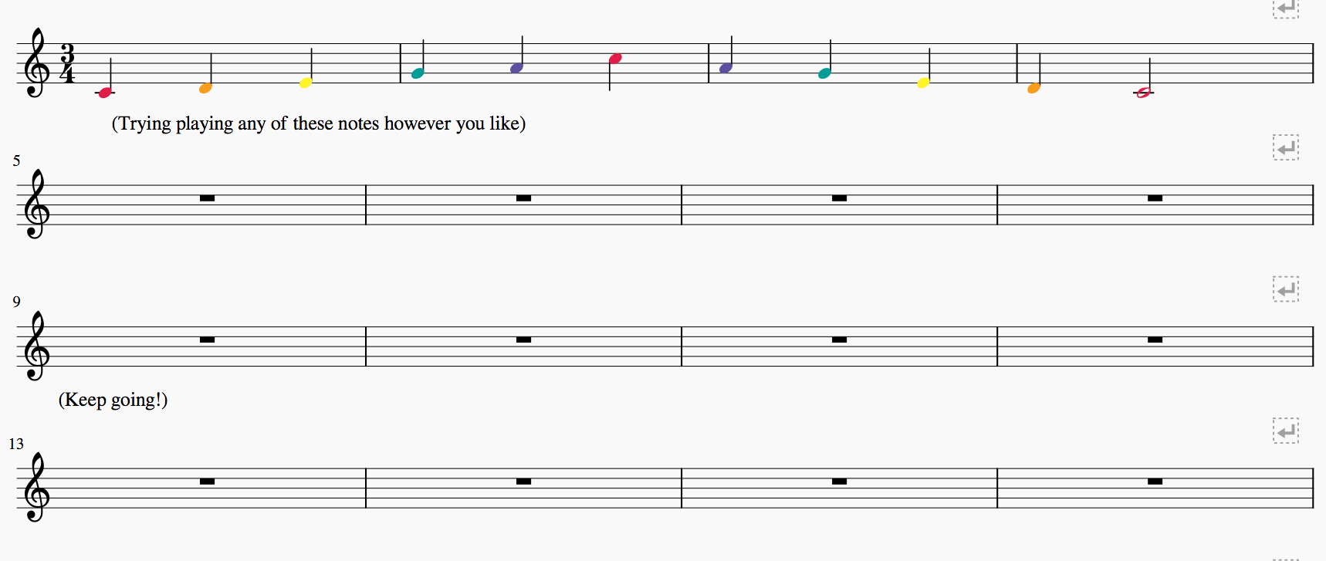
Try playing a mix of long and short notes, how do they sound?

Slide 10
