Slide 1
Insert yourschool logo here
Music at YOUR SCHOOL NAME
Presenters name
Key points about music
and its value in your school
How great your school music is
Quote from pupil or parent?

Slide 2
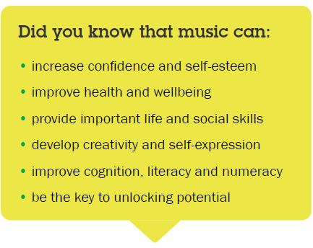
Insert yourschool logo here

Slide 3
Pathways to the world of work and careers
Insert yourschool logo here
Music is one of the Creative Industries ……………..
The Creative Industries contributed almost £13 million to the UK economy every hour (2020).
The Creative Industries are growing more than five times faster than the national economy.
Broadband, internet and digital make careers in music and the creative industries more accessible to young people in Wiltshire than ever before.
wiltshiremusicconnect.org.uk/careers/

Slide 4
#DontDropMusic
Insert yourschool logo here
An upbeat, positive and optimistic campaign to raise awareness of children and young people’s music making opportunities in Wiltshire during the Covid-19 pandemic.
Notes:
You link to and show our film if you wish https://youtu.be/KiCUDsbqqn4

Slide 5
Learning in school can progress on to other things...
Insert yourschool logo here
Learning to play an instrument or sing is just the start of a musical journey.
Our school and Tutors and Music Leaders can connect pupils to other opportunities to progress their musical experience and learning, these include a range of clubs, choirs, groups and ensembles.
School’s own ensembles as examples

Slide 6
Meet the instrumental tutors working in our school
Insert yourschool logo here
Our school uses a number of Associates of Wiltshire Music Connect (the music education hub for Wiltshire).
Associates are quality assured professional tutors with an appropriate range of skills and experience.
We also use some other tutors

Slide 7
Insert yourschool logo here
Tutor #1 NAME
INSERT tutor’s video or photos here (unless you are running them in a separate show)
Name
Instruments offered / taught
INSERT A QUOTE FROM A PUPIL IN YOUR SCHOOL?

Slide 8
Insert yourschool logo here
Tutor #2 NAME
INSERT tutor’s video or photos here (unless you are running them in a separate show)
Name
Instruments offered / taught

Slide 9
Insert yourschool logo here
Tutor #3 NAME
INSERT tutor’s video or photos here (unless you are running them in a separate show)
Name
Instruments offered / taught

Slide 10
Insert yourschool logo here
Interested in taking up lessons?
Please list here who in the school team they talk to
When they need to do it by
Whether you’re offering ‘taster’ sessions or not
Whether they need to fill in any forms
Etc etc

Slide 11
If you might need help with the cost of tuition…
Insert yourschool logo here
Our school can request subsidy towards the costs of tuition (and an instrument) for pupils in need of support – this is only available when a pupil is receiving tuition from a Wiltshire Music Connect Associate.
*Subject to criteria and availability

Slide 12
Insert yourschool logo here
What about an instrument?
When a pupil is receiving tuition from a Wiltshire Music Connect Associate they can access a competitively priced Instrument Hire Scheme.
Pupils in need of support with the cost of tuition can also access free instruments.

Slide 13
Insert yourschool logo here
I’m not sure about starting if my tuition might be disrupted…
Our school and tutors have plans in place which mean that a child’s tuition can continue even if they (or their class group) have to isolate.
Tutors are able to provide tuition online and have updated safeguarding measures in place.
If a child might need help with a suitable device at home, a tablet may be available through Wiltshire Music Connect

Slide 14
Insert yourschool logo here
THANK YOU
All our tutors & music leaders
Our young musicians
The village cat
Wiltshire Music Connect - the music education hub for Wiltshire

