Slide 1

Commissioned by
Words and Music by Tim Gilvin and Louise Jordan
Words and Music by Tim Gilvin and Louise Jordan

Slide 3

Together
Together
In homes and towns, round Salisbury Plain
Our voices apart, but our song’s the same
Together

Slide 4
Through rolling fields and farming land
Under planes and on canals
We see beautiful butterflies landing on flowers
And oak trees waving us by
Together
Together
In homes and towns, round Salisbury Plain
Our voices apart, but our song’s the same
Together

Slide 5
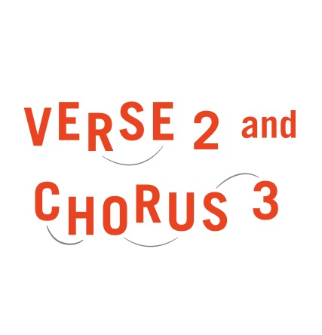
On bustling high streets, in town halls
On roads and cycle paths on market stalls
We see rainbows in windows and signs to explore
And neighbours waving us by
Together
Together
In homes and towns, round Salisbury Plain
Our voices apart, but our song’s the same
Together

Slide 7
From stones that have stood five thousand years
Cathedrals and castles built right here
We see factories and farms that went before
Our history waving us by
Together
Together
In homes and towns, round Salisbury Plain
Our voices apart, but our song’s the same
Together

Slide 9
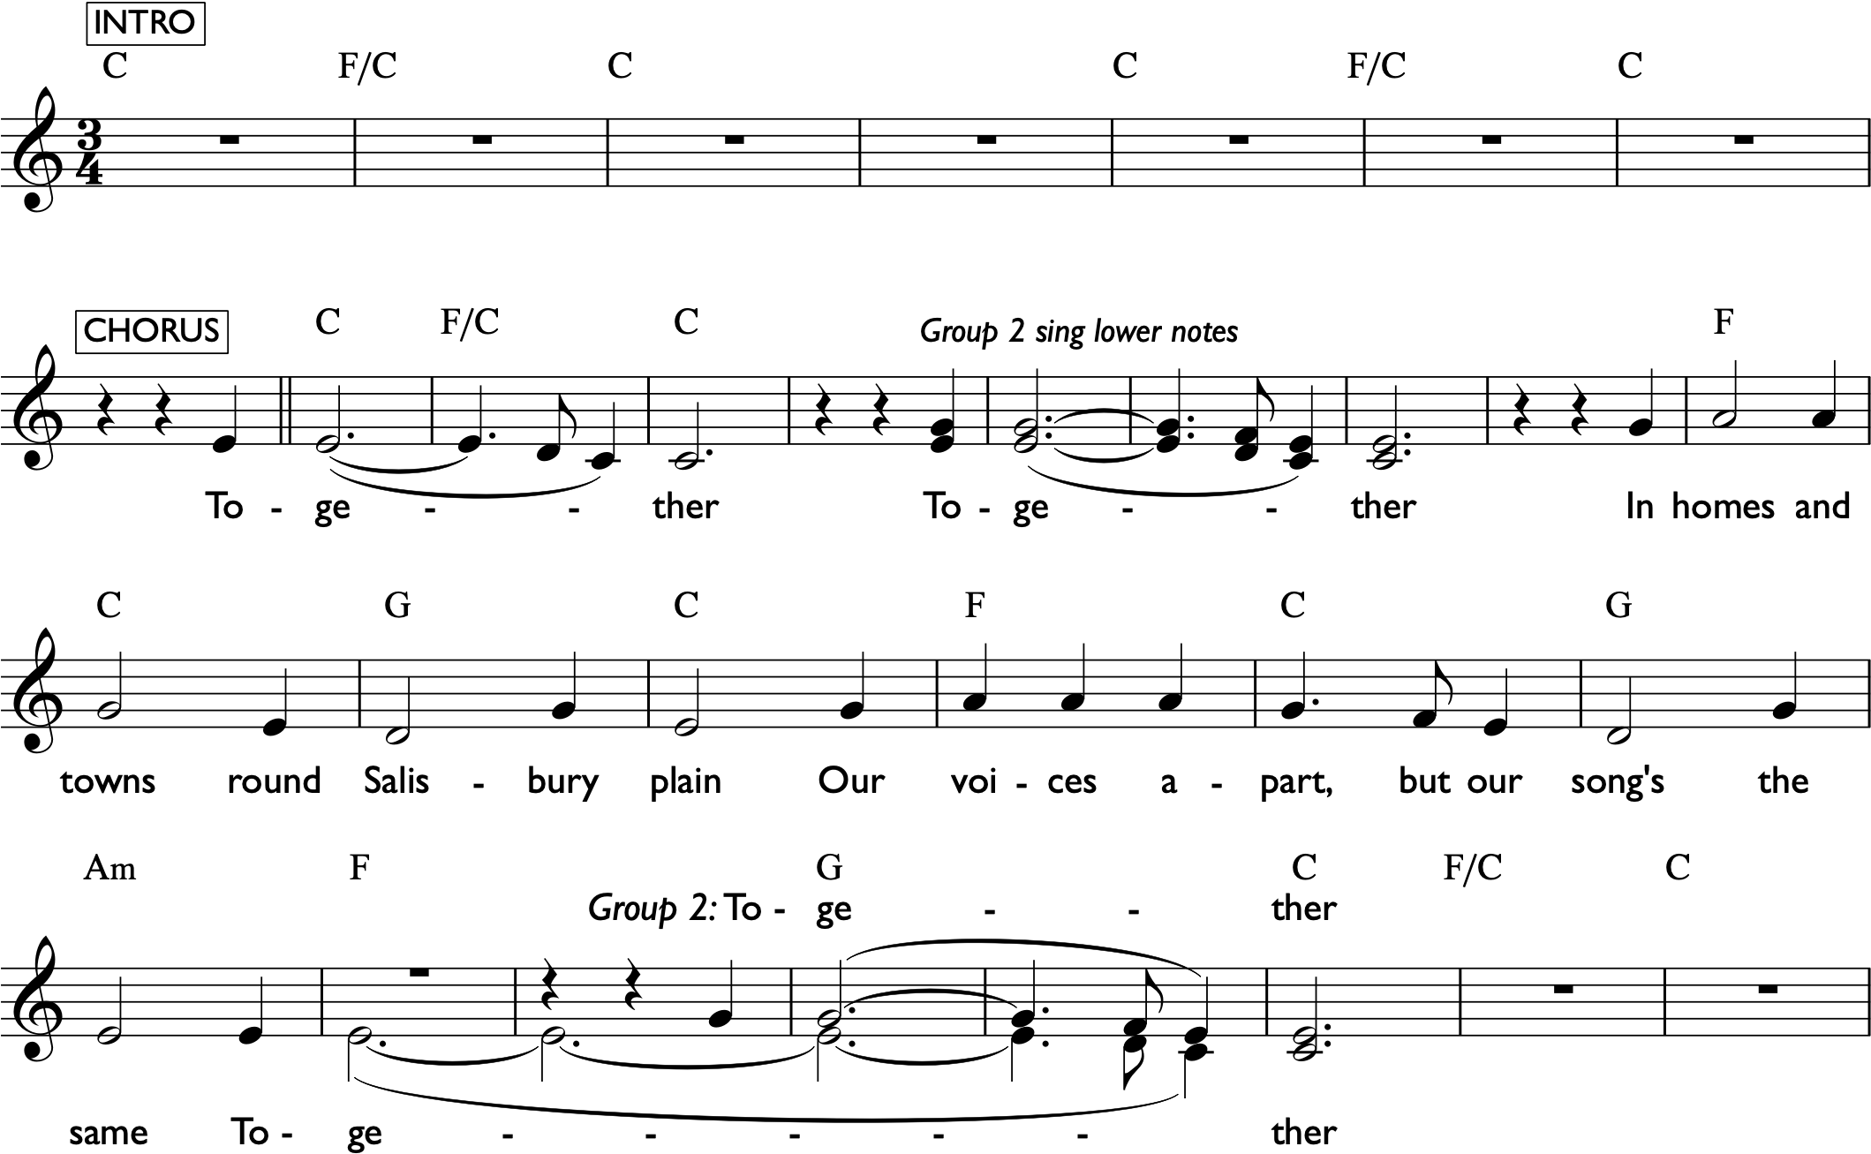

Slide 10
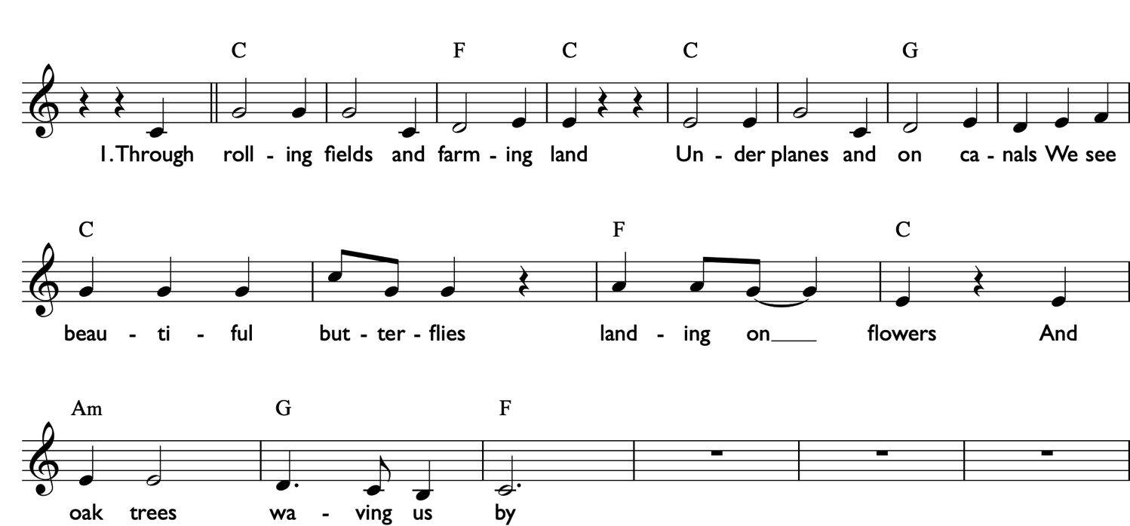

Slide 11
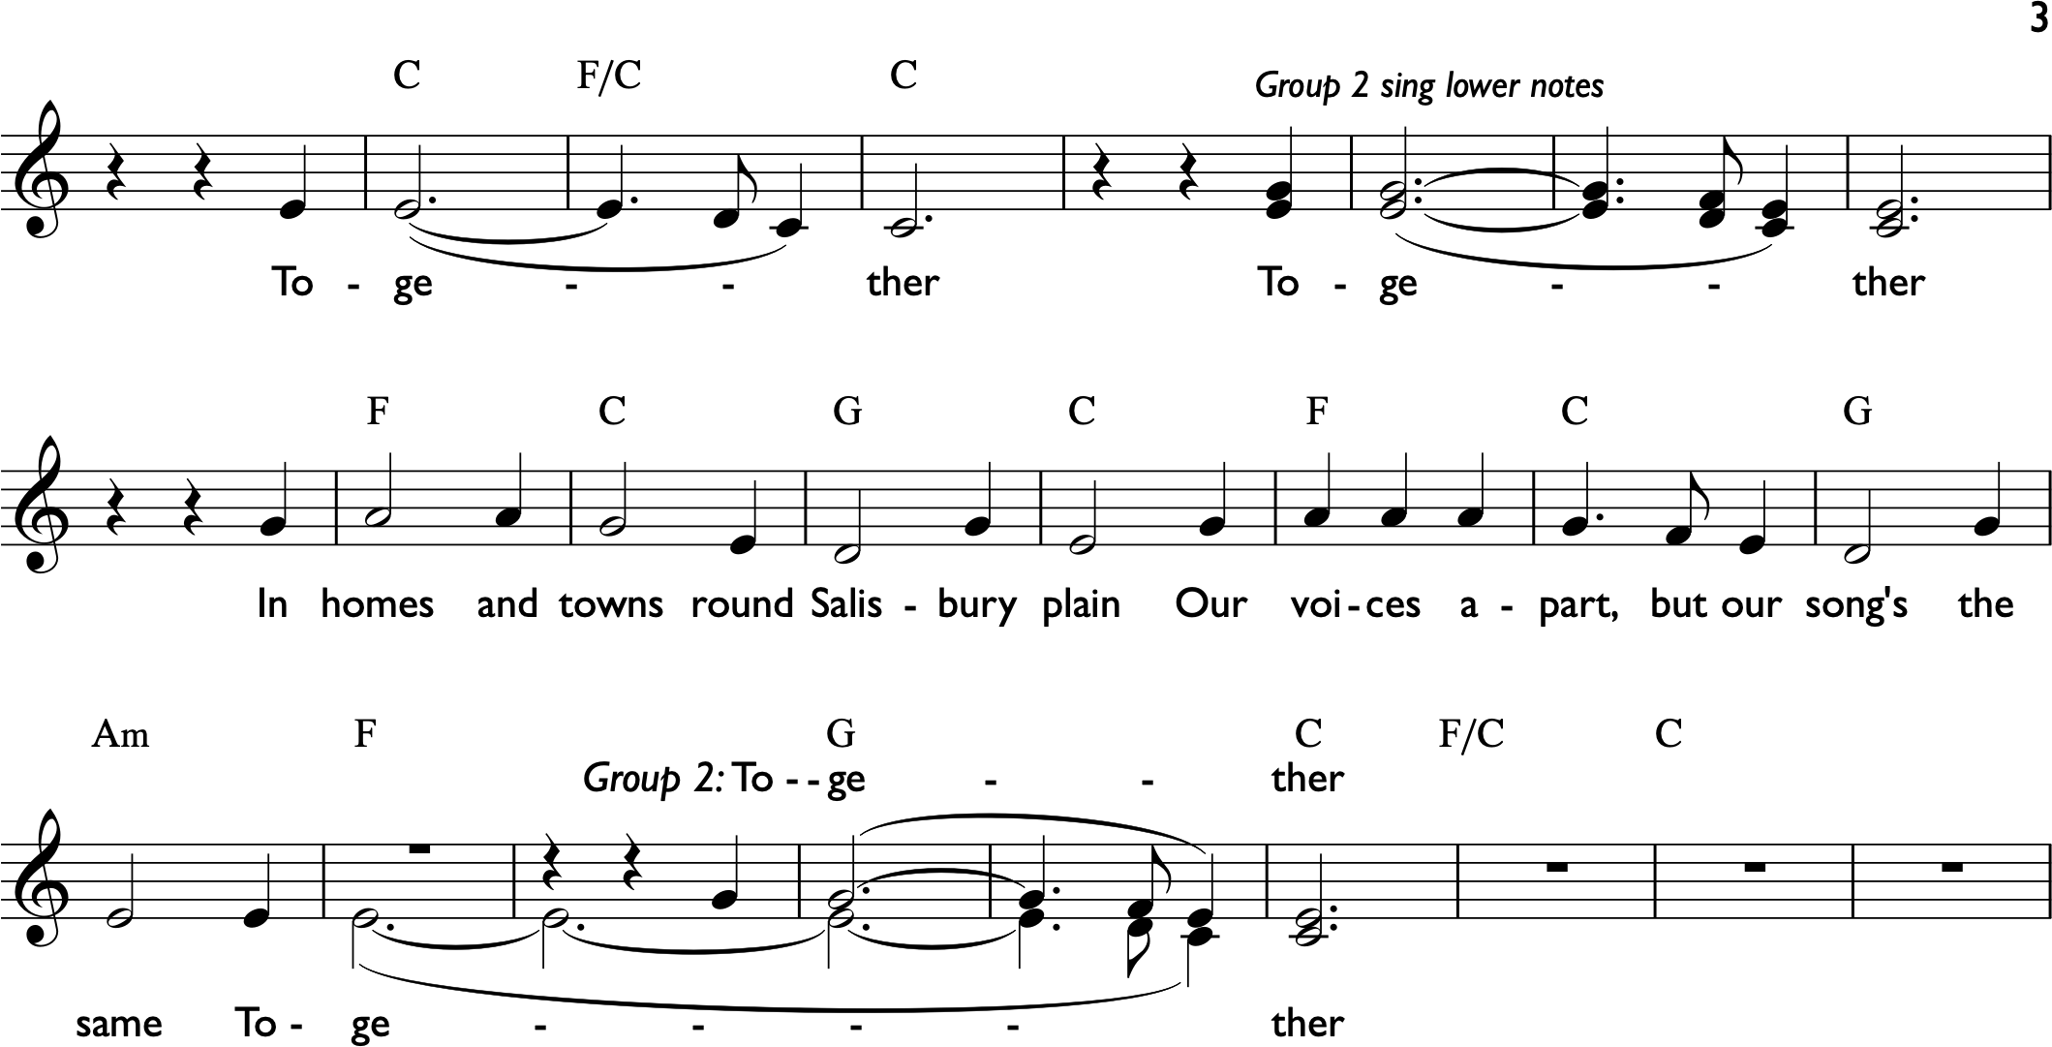

Slide 12
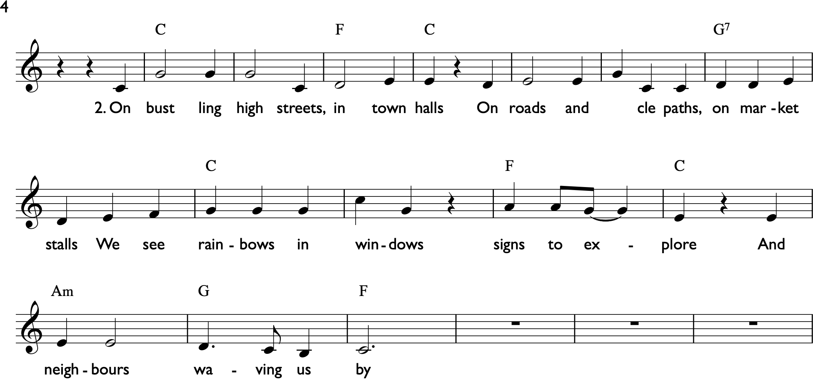
Score - Verse 2

Slide 14
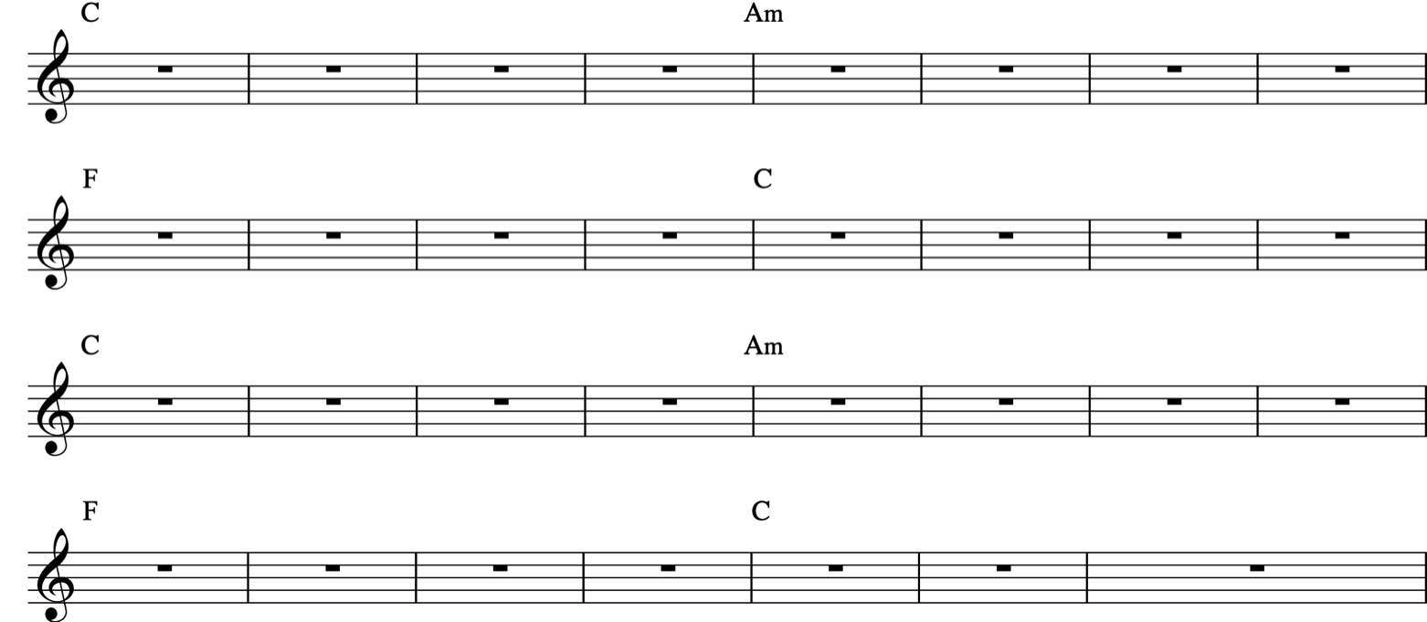

Slide 15
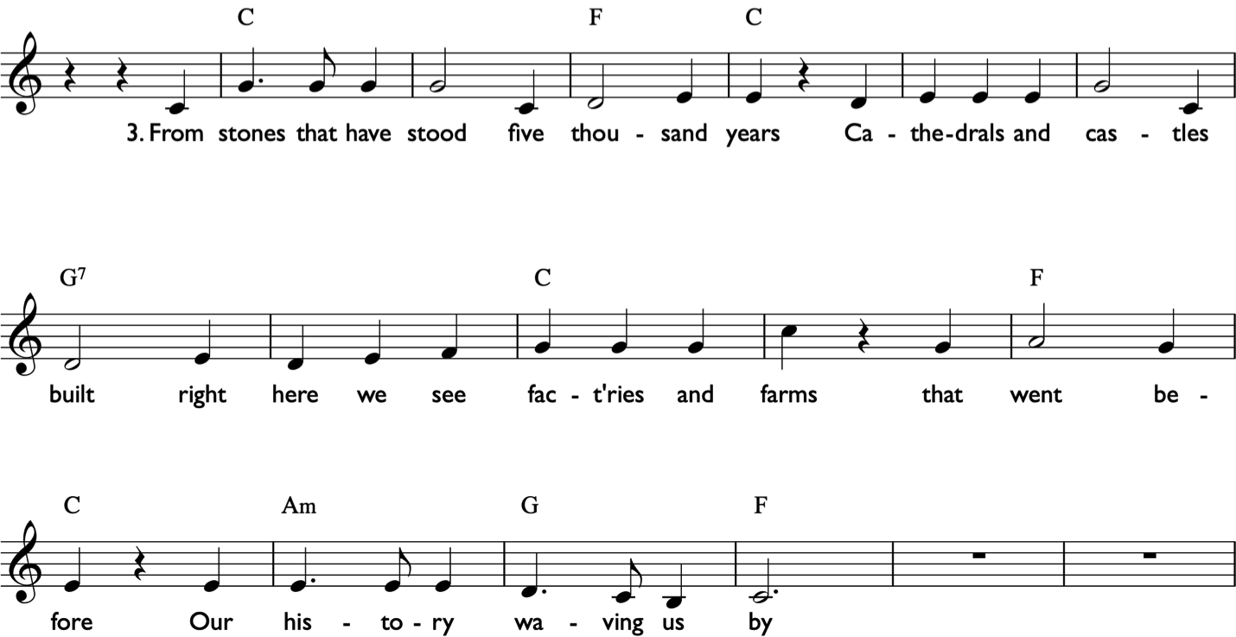

Slide 16
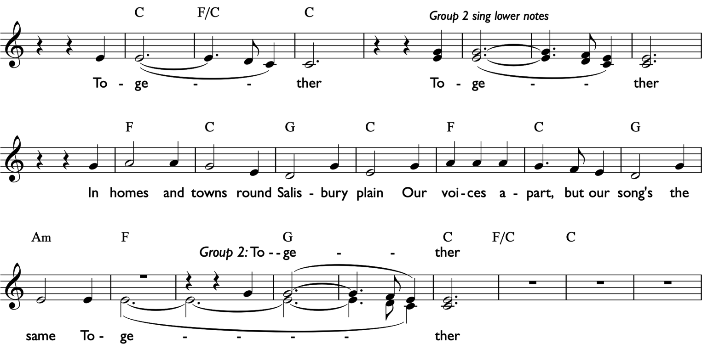

Slide 18
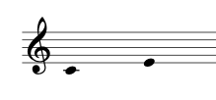


Slide 19

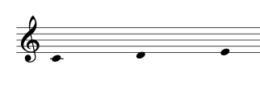

Slide 20

