Slide 1
February 2024
Careers in the music industry
some facts, figures and where to find out more

Slide 5
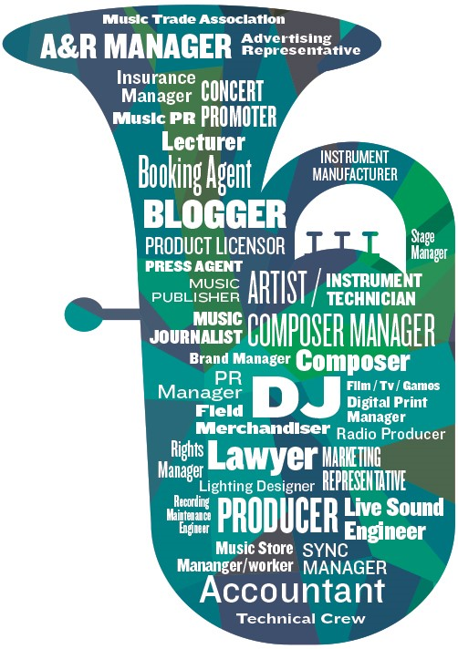

Slide 6
Portfolio Career

Slide 7
Where could I work?
Anywhere! Nowadays, you don’t have to head to London. In fact, many people are creating and growing their own regional music businesses and communities. And high-speed broadband makes it even easier to work from any location.

Slide 8
Myths busted!
It’s a risky business and there’s no future in it
Actually, following a dip in the numbers caused by the pandemic, the music industry in the UK is now growing rapidly again.
UK music industry’s contribution to the UK economy in 2021 was £4 billion
Employment in the music industry rose to 145,000 jobs in 2021
Exports in the sector rose in 2021 to £2.5 billion
You can check for updated stats here

Slide 9
Myths busted!
You need a record deal or you’ll never make any money
Not true! More and more musicians are taking their careers into their own hands, by recording and producing their own music, streaming and sharing their work and booking their own gigs. Many supplement this income with other jobs in the industry too.
There’s no solid training pathway
Nowadays, there are many pathways including apprenticeships, internships, qualifications, and training (including online) for a variety of careers in the industry

Slide 10
Where can I find out more?
https://wiltshiremusicconnect.org.uk/careers/
Notes:
Links on Careers leaflet

