Slide 1
Exploring language used in education.
Steph Farr
stephfarr.musiceducation@mail.com

Slide 2
You will take away opportunities to:
relate wider educational context to your own work
reflect on ways to explain your teaching methods using current terminology
feel more confident should you need to discuss your teaching with school staff, Ofsted or other stakeholders

Slide 3
Befuddle: (verb) to confuse, discombobulate
“This is clearly designed to befuddle us all.”
*Synonyms: bewilder, boggle, stupefy
*Antonyms: demystify, clear up

Slide 4
“To enable all children and young people to learn to sing, play an instrument and create music together, and have the opportunity to progress their musical interests, including professionally”
NPME June 2022
3 main goals:
All children and young people receive a high-quality music education in the early years and in schools
Schools working in partnership with Music Hubs
Supporting progression and furthering music development

Slide 5
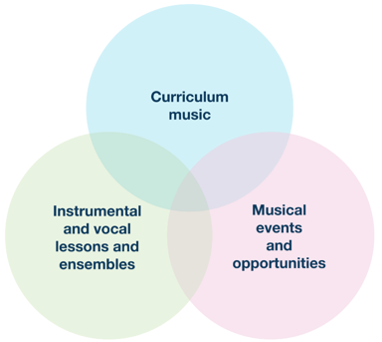
Case study NPME June 22
Model of music education originally created by Hampshire County Council’s Music Service, 2013. All rights reserved.

Slide 6
“The central purpose of good music education is for pupils to make more music, think more musically, and consequently become more musical”.
Ofsted Research Review for Music July 21.

Slide 7
“Effective delivery is likely to come from a combination of schools, teachers, practitioners, professional ensembles, venues and Music Education Hub partners working collaboratively” Model Music Curriculum

Slide 8
“All music educators work in partnership, with children and young people’s needs and interests at their heart”
“All children and young people with musical interests and talents have the opportunity to progress, including professionally”
Revised National Plan for Music Education, June 2022

Slide 9
What on earth are they talking about?!
a) 3 Is
b) Progression
c) Sequential Learning
e) Assessment
d) Feedback
f) Learning Needs
g) Equity, Diversity, Inclusion

Slide 10
The Jargon - Demystified
3 ‘I’s | “What are your pupils going to learn?” (Intent) “How are you going to make this happen?” (Implementation) “Has your teaching been effective?” (Impact)
Progression | “If nothing has altered in long-term memory, nothing has been learned.”
Sequential Learning | “The order in which knowledge and skills are taught is therefore important.”
Feedback | “What went well, even better if.”
Assessment | “When used effectively, it helps pupils to embed knowledge and use it fluently and assists teachers in producing clear next steps for pupils.”
Learning Needs | “You need to vary teaching and learning activities to cater for each learner.”
Equity, Diversity, Inclusion | “Every pupil needs a chance…”

